Slide 1
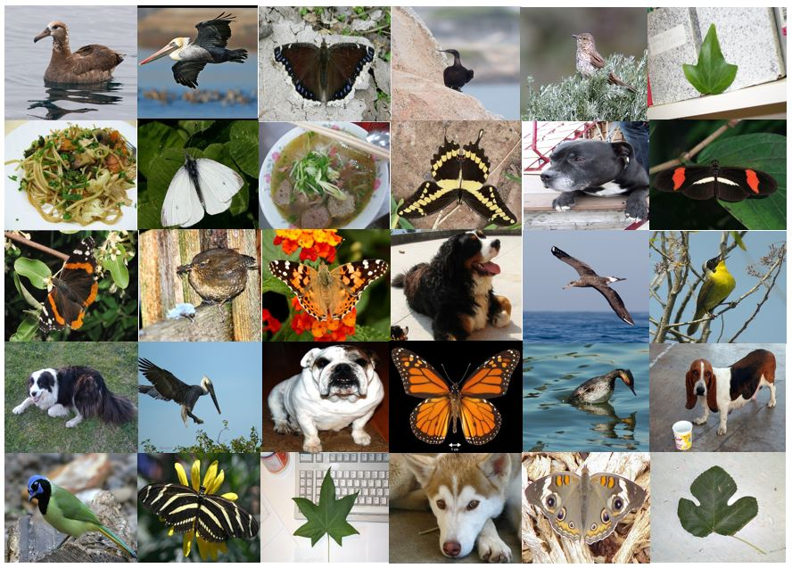
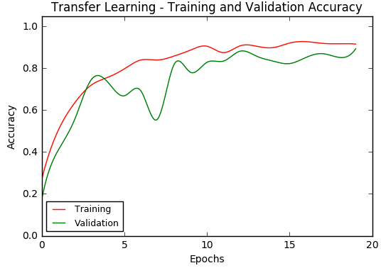
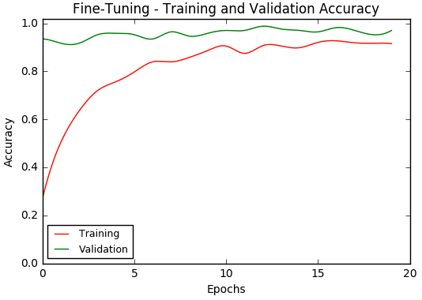
Image Classification with Transfer Learning
Harpreet Bhasin

Slide 2
The Objective
Use the publicly available Keras library to perform image classification on a variety of small datasets with different domains using Transfer and Fine Tuning with the following ImageNet pre-trained models:
VGG16
VGG19
Inception V3
Xception
Build and train a simple one-layer Convolutional Neural Network to perform image classification on a two-class dataset
Build and train a six-layer Convolutional Neural Network to perform image classification on a two-class dataset
Compare the training times and accuracies of these models

Slide 3
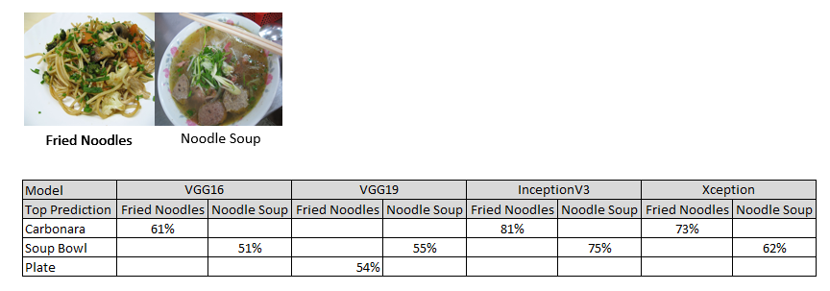
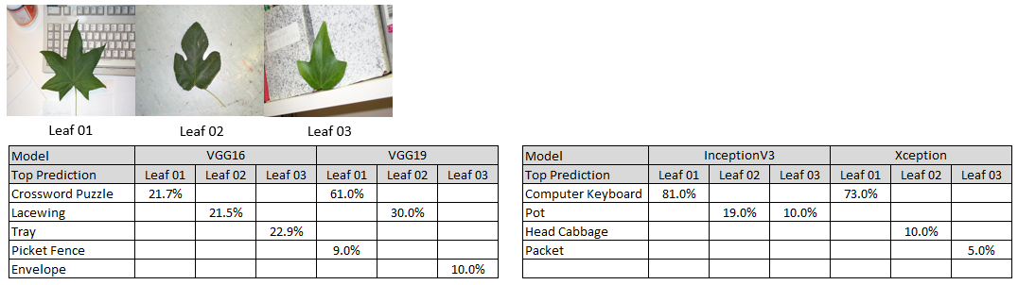
Quick Check on ImageNet pre-trained Model Capability – Noodles/Leaves
Only VGG19 had difficulty
All models unable to identify leaves. Closest was Pot

Slide 4
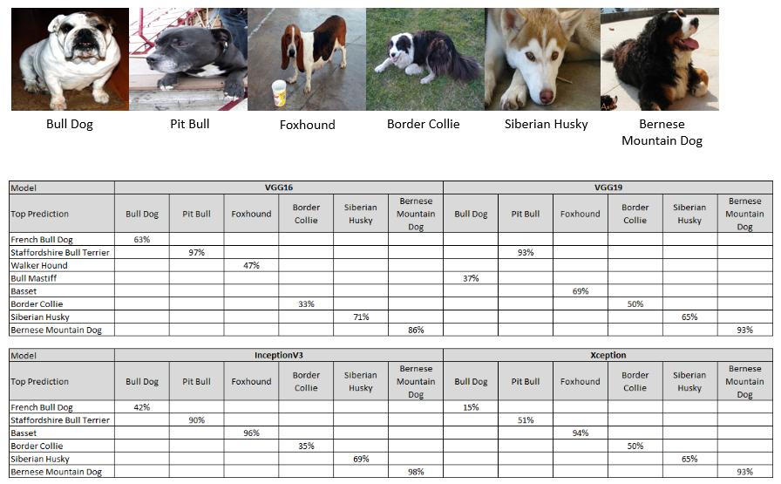
Quick Check on ImageNet pre-trained Model Capability - Dogs
All models identified Border Collie, Siberian Husky and Bernese Mountain Dog images accurately

Slide 5
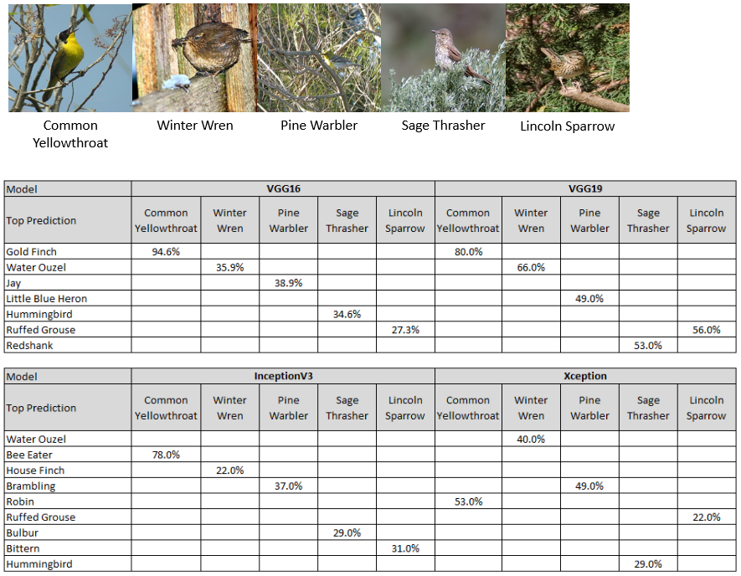
Quick Check on ImageNet pre-trained Model Capability – Birds [1]
All models identified images as some kinds of birds

Slide 6
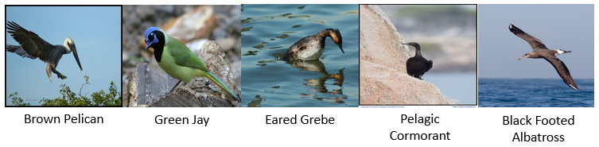
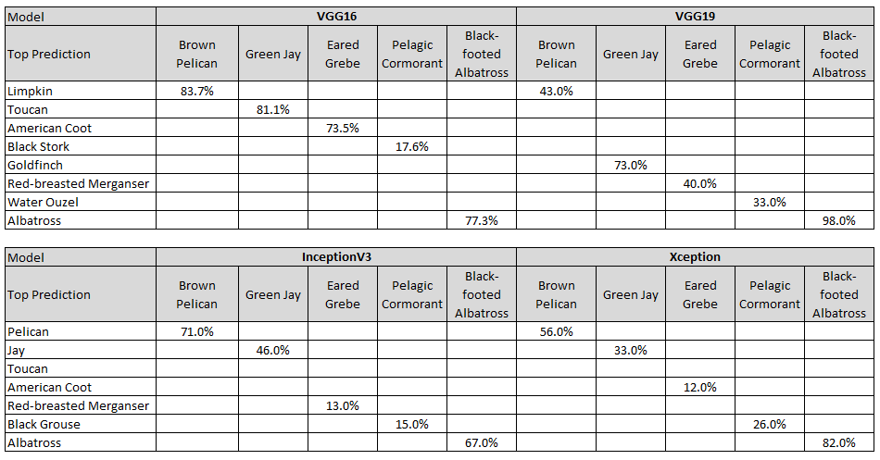
Quick Check on ImageNet pre-trained Model Capability – Birds [2]
All models identified images as some kinds of birds

Slide 7
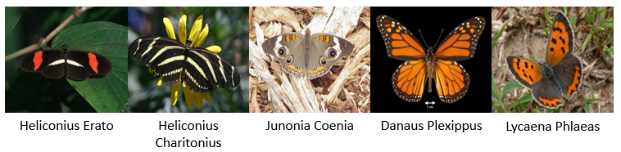
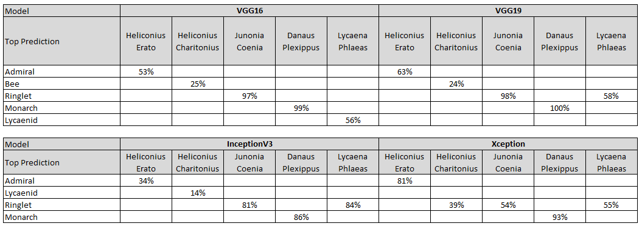
Quick Check on ImageNet pre-trained Model Capability – Butterflies [1]
All models identified images as some kinds of butterflies except ones highlighted

Slide 8
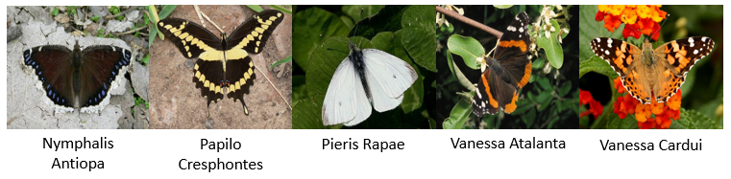
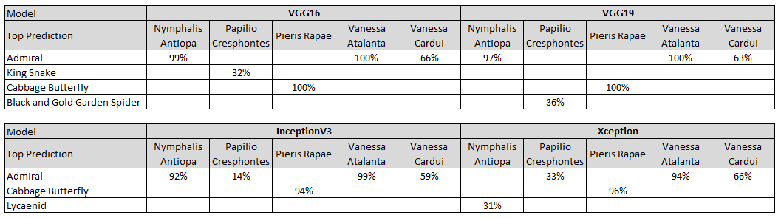
Quick Check on ImageNet pre-trained Model Capability – Butterflies [2]
All models identified images as some kinds of butterflies except ones highlighted

Slide 9
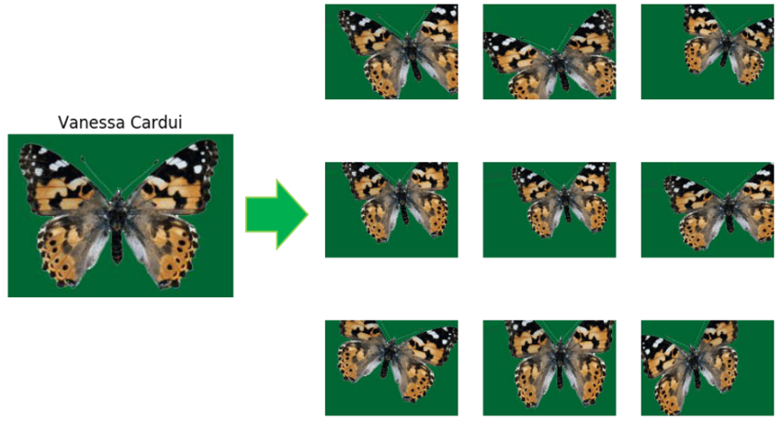
Data Augmentation Effect
Rotation,
Height Shift,
Width Shift,
Shear,
Horizontal Flip

Slide 10
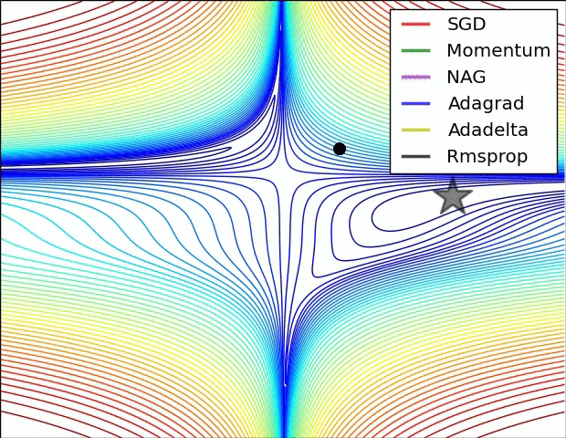
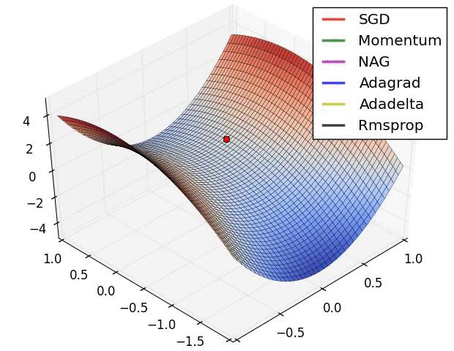
Learning Process Animation
Left: Contours of a loss surface and time evolution of different optimization algorithms. Notice the "overshooting" behavior of momentum-based methods, which make the optimization look like a ball rolling down the hill.
Right: A visualization of a saddle point in the optimization landscape, where the curvature along different dimension has different signs (one dimension curves up and another down). Notice that SGD has a very hard time breaking symmetry and gets stuck on the top. Conversely, algorithms such as RMSprop will see very low gradients in the saddle direction. Due to the denominator term in the RMSprop update, this will increase the effective learning rate along this direction, helping RMSProp proceed. Source: CS231n. Images credit: Alec Radford.

Slide 11
Transfer Learning Process
Quick check pre-trained model’s capability
Load and pre-process Data
Define Model
Compile Model
Fit (Train) Model
Evaluate Model
Test Model

Slide 12
Fine Tuning Process
Determine Layers to train
Compile Model
Fit (Train) Model
Evaluate Model
Test Model

Slide 13
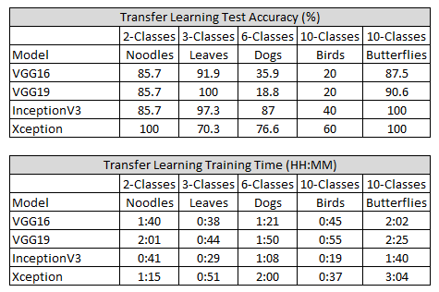
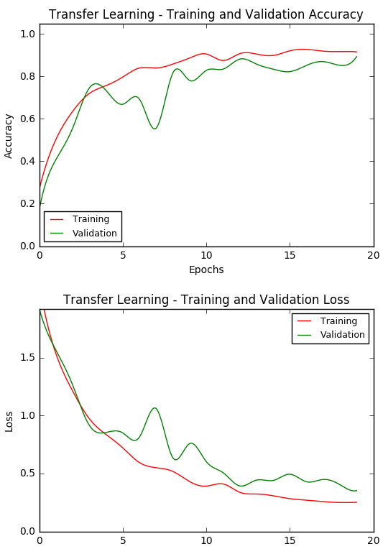
Transfer Learning Test Results
Highlighted cells indicate models needed fine tuning
Inception V3 was the best performing model, followed by Xception, VGG16 and VGG19

Slide 14
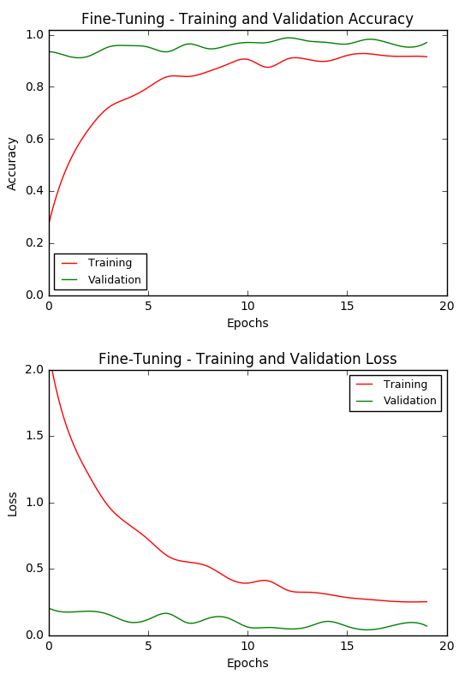
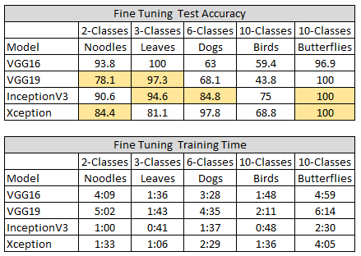
Fine Tuning Test Results
Highlighted cells indicate no improvement or there was a loss in accuracy
Inception V3 was the best performing model, followed by Xception, VGG16 and VGG19

Slide 15
Next Steps
Amazon Web Services (AWS) EC2, Google Cloud Platform and Paperspace offer Virtual Machines (VM) with multiple GPU support for use in deep learning projects. Use these alternative resources to increase number of epochs from 20 to 50 to validate increase in training accuracy.
ResNet50 is the CNN model that the Microsoft team developed to win the Large Scale Visual Recognition Challenge(ILSRVC) 2015 competition and which surpassed the human performance on the ImageNet dataset. However, it failed to perform as well as any of the other four models used in this project. This needs to be further investigated.
Tensorflow from Google is another very popular library used for computation in neural networks. The Keras library has the capability to run on top of Tensorflow or Theano. It would be interesting to compare the performance of the pre-trained ImageNet Inception V3 model using Tensorflow against Keras.

